Slide 1
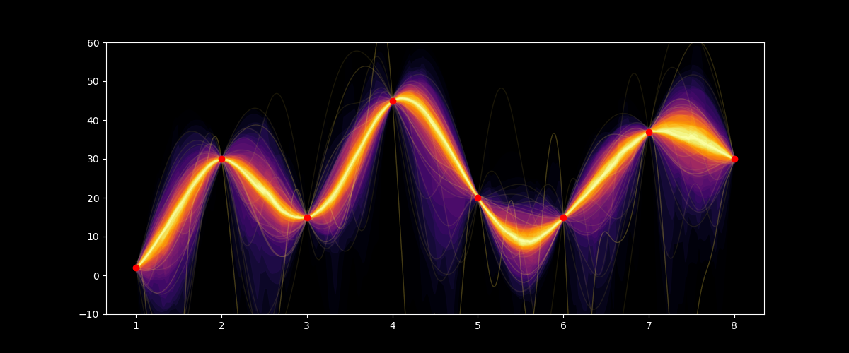
Predicting Solar Activity Cycles using Probabilistic Machine Learning
GUNER AYGIN
Notes:
Good afternoon, everyone. Thank you for joining me today to hear about my master's project on "Predicting Solar Cycles using Probabilistic Machine Learning".

Slide 2
SEMINAR TIMETABLE
Introduction to Solar Cycles
Motivation
Existing Research
Probabilistic Machine Learning
My approaches
Conclusion
Notes:
In this presentation, I will begin by explaining what solar cycles actually are, the factors that cause them, and the importance of studying them.
From here we will move on to briefly discuss some of the existing research on the topic, before diving into what I have been up to for the last semester and a half.
Namely, I would like to introduce you all to some of the techniques I have been deploying to predict solar cycles, with a focus on a promising technique known as “Gaussian Processes”.

Slide 3
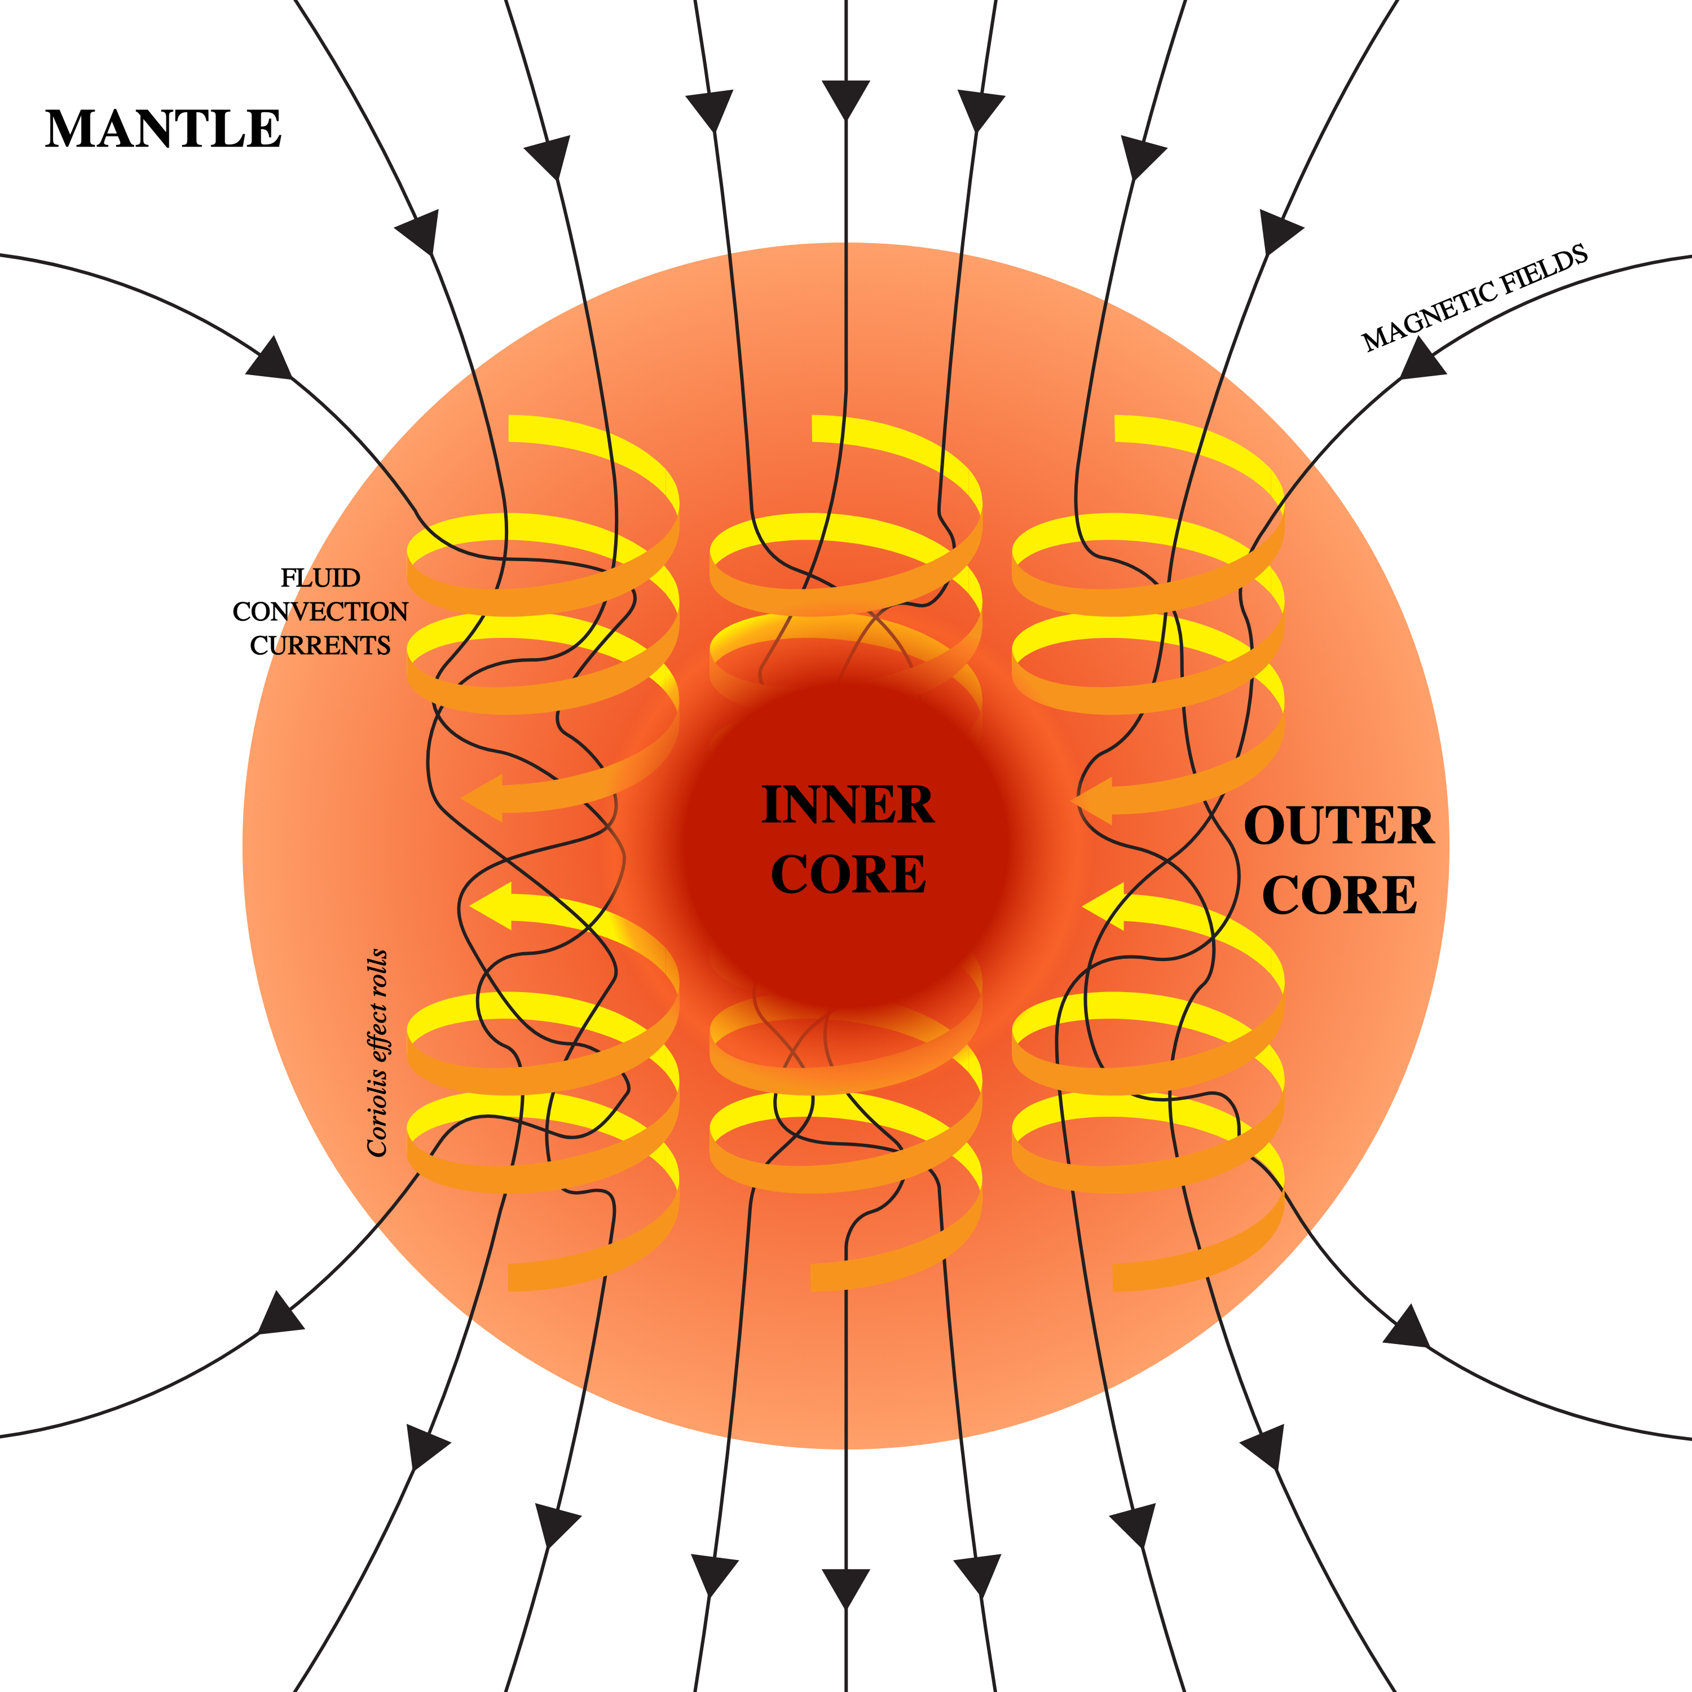
WHAT ARE SOLAR CYCLES?
Sun is made of a convective plasma
Moving charges generate a magnetic field – ‘dynamo process’
Magnetic field fluctuates every 11 years – The Solar Cycle
Complex physics - ongoing area of research
Notes:
So lets start by explaining what solar cycles actually are. The sun is composed of plasma; a complex soup of electrons and ions that are in constant motion due to convection within the Sun.
As we all know, a moving charge (such as these ions) generates a magnetic field. In the case of the Sun, the movement of all these charged particles generates a magnetic field and we call this mechanism the dynamo process.
This diagram here does a really good job of showing how these swirling convection currents create the Sun's overall magnetic field.
That is an oversimplification of what really goes on inside the Sun
What the diagram fails to show us is that in reality the Sun's magnetic field is not static. Due to the convective motion in the outer layers of the Sun, the magnetic field lines become stretched and twisted, leading to a complexity that fluctuates between periods of weak and strong magnetic activity. This phenomenon is known as the Solar Cycle and occurs approximately every 11 years.
It is important to note that the dynamo process and the Sun's magnetic field are still an ongoing area of research and understanding them requires a deep understanding of plasma physics, magnetohydrodynamics, and other complex physics concepts. Nevertheless, the mystery of the Sun's magnetic field makes this a very exciting topic of research

Slide 4
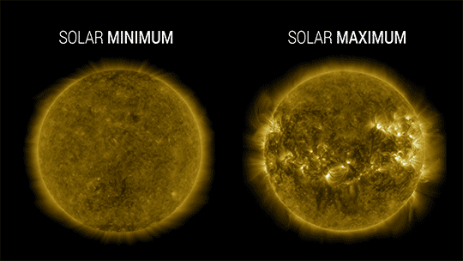
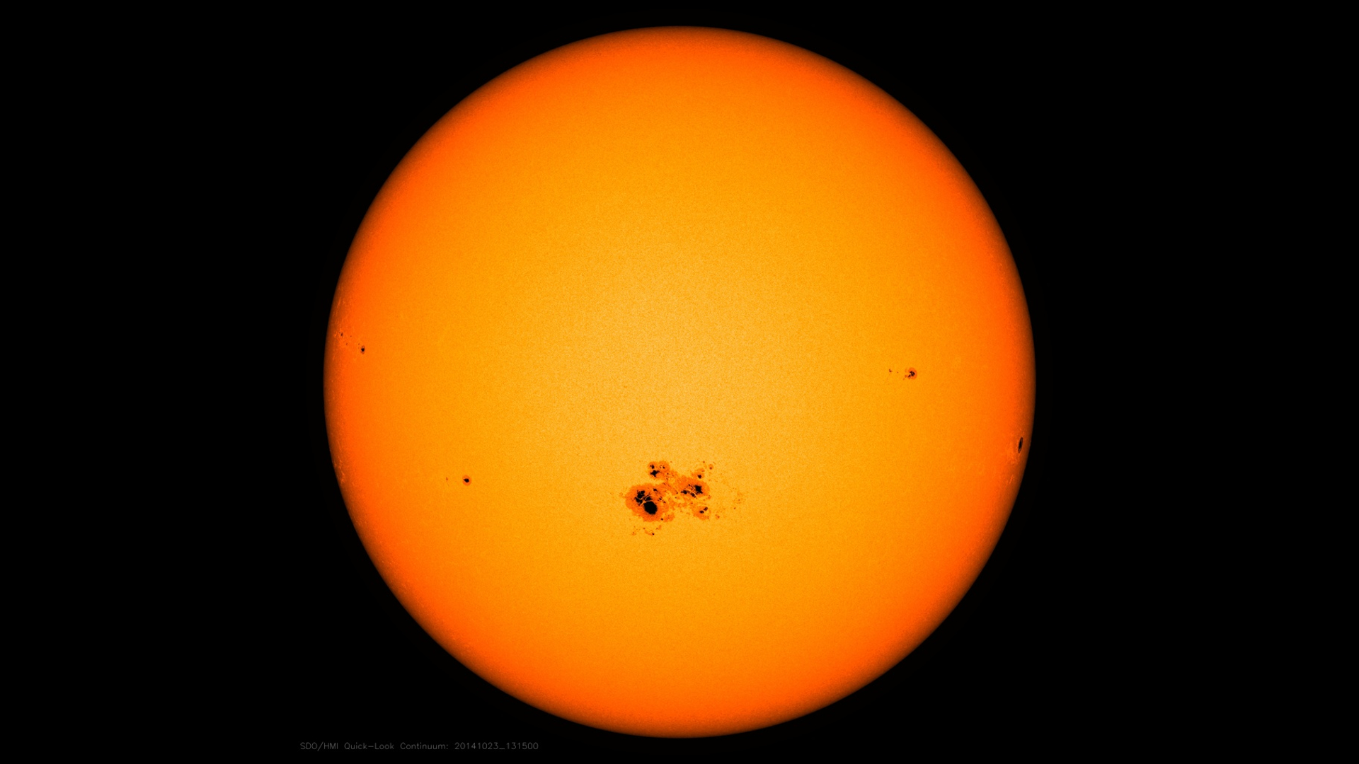
WHAT ARE SOLAR CYCLES?
Notes:
The way we measure the strength of these solar cycles, whether the activity is high or low, is by counting the number of sunspots which are visible on the solar surface. More sunspots = higher solar activity.
So when we try to predict what the solar activity will be, all we’re saying is we want to know how many sunspots there will be and when they will be there.
And that looks something like this. So this is the raw data that I have been using in my project.
Hopefully, you can all see the roughly 11-year periodicity of the cycles which I have mentioned.
We will be returning to this dataset in one form or another later on, but for the moment I would like to emphasise that each of these cycles has a different shape. To give you an example of what I mean, have a look at the amplitude for each of those cycles. They are all different, and they don’t really seem to have a pattern to them. Thus far it has proven very difficult to predict those shapes, which is what this project is all about.

Slide 5
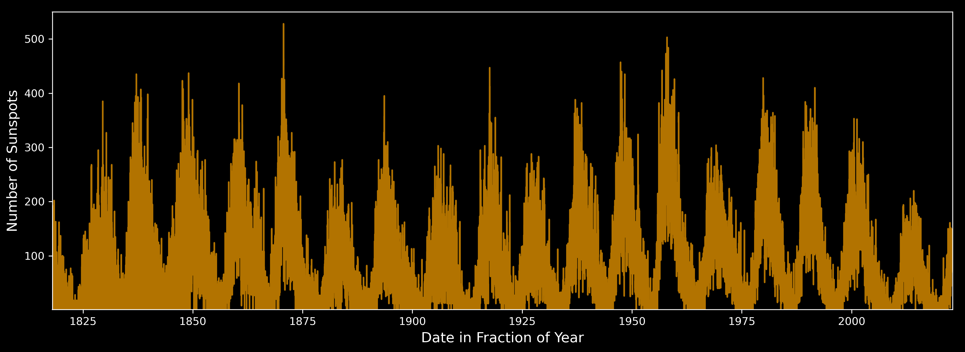
WHAT ARE SOLAR CYCLES?
Predicting solar cycles = Predicting sunspot number
Notes:
The way we measure the strength of these solar cycles, whether the activity is high or low, is by counting the number of sunspots which are visible on the solar surface. More sunspots = higher solar activity.
So when we try to predict what the solar activity will be, all we’re saying is we want to know how many sunspots there will be and when they will be there.
And that looks something like this. So this is the raw data that I have been using in my project.
Hopefully, you can all see the roughly 11-year periodicity of the cycles which I have mentioned.
We will be returning to this dataset in one form or another later on, but for the moment I would like to emphasise that each of these cycles has a different shape. To give you an example of what I mean, have a look at the amplitude for each of those cycles. They are all different, and they don’t really seem to have a pattern to them. Thus far it has proven very difficult to predict those shapes, which is what this project is all about.

Slide 6
MOTIVATION
High levels of UV & X-Ray radiation
Affects space weather – Satellites, GPS & Power grids
Impact on climate on Earth
Exoplanet Detection
Notes:
So why do we even care about predicting these solar cycles?
Well, solar activity can have a range of effects on Earth, including amplifying the harmful UV & X-ray radiation dose absorbed by astronauts, airline pilots and passengers.
The activity also affects the weather in space. This can damage our communication systems and even disrupt our power grids. Suffice to say that these are very expensive to repair or replace, and so there is a global incentive to forecast how strong these cycles will be, to better safeguard against these disruptions.
In addition, recent studies have suggested that the sun's activity may also have an impact on Earth’s climate and our ability to detect exoplanets
Because other stars also undergo similar cycles, and that adds an extra source of noise to exoplanet data, and could even lead to a false positive.
Given the significance of solar cycles and their impact on Earth and in research, predicting them accurately is crucial for mitigating potential hazards and understanding their potential impact on our planet.

Slide 7
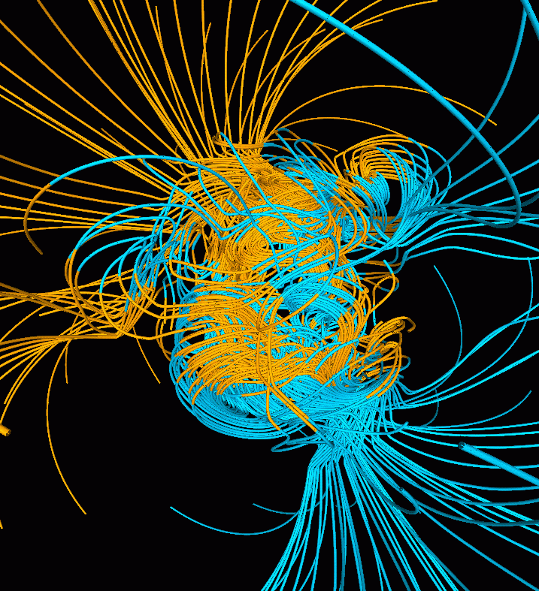
THE PHYSICS APPROACH
Charbonneau – ‘Simulation of the dynamo process within the Sun’
Simulates Maxwell’s equations
Very computationally expensive
The theory still not well understood
No concrete predictions
Simpler models are needed!
Notes:
So, people have already tried to predict these cycles, and the first method I want to shed light on is what I’m calling the ‘physics approach’.
As physicists, our first attempt at trying to predict these cycles might be to create a simulation of everything going on inside the Sun, notably simulating Maxwell’s equations, so that we can see how the magnetic field evolves over time, and that would be really cool to try.
Fortunately, this has already been done before by Charbonneau. Unfortunately, this method struggles at predicting solar cycles because of two main points.
Firstly, these simulations take a lot of time and power to run. Secondly, because dynamo theory is still not fully understood, our simulations are not perfect, and will quickly deviate from reality.
So, whilst this is super interesting and will help us understand the inner workings of the Sun, it’s pretty useless at predicting solar cycles.

Slide 8
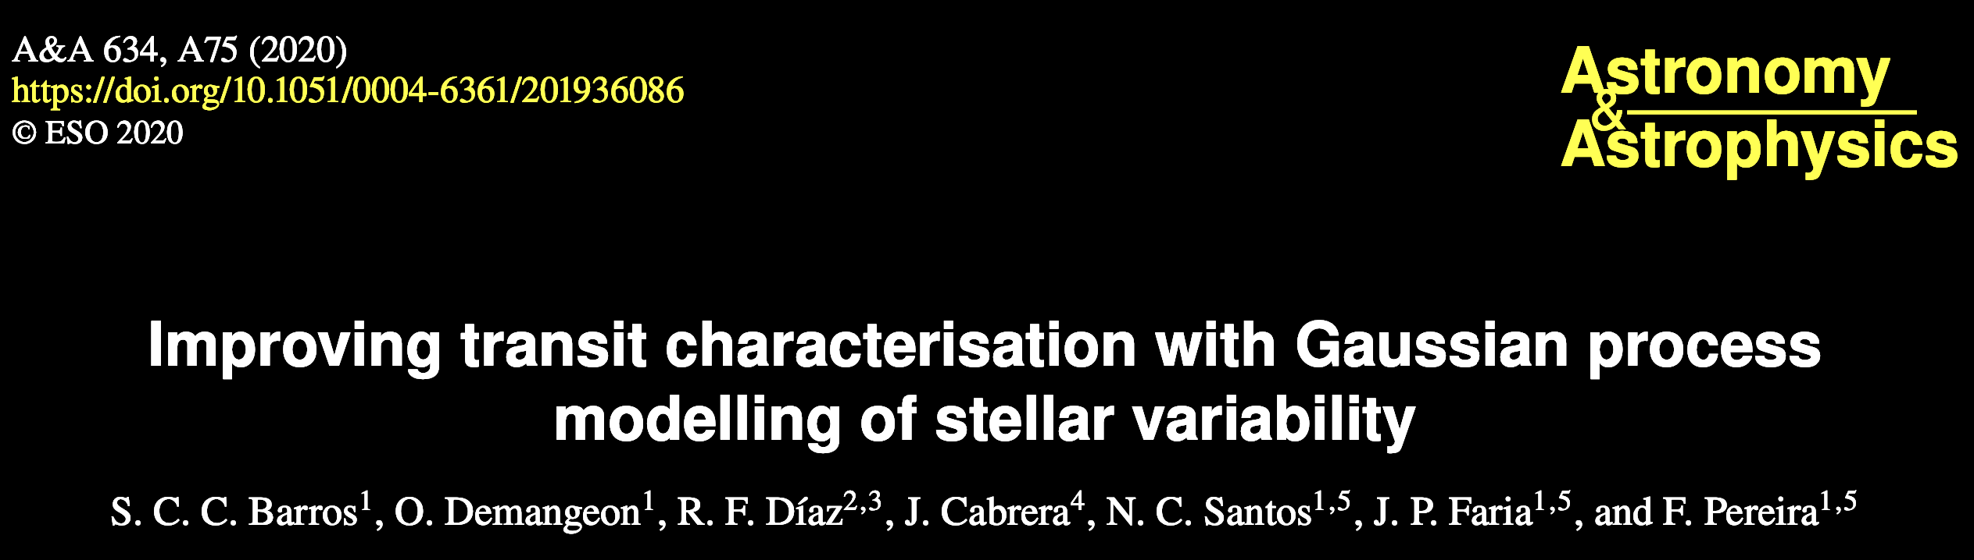
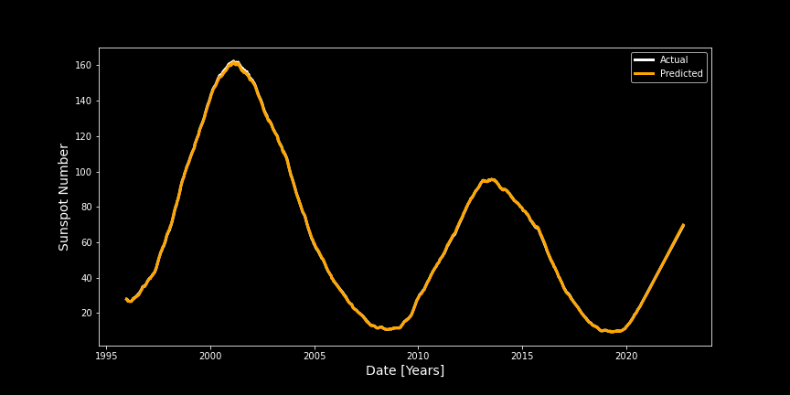
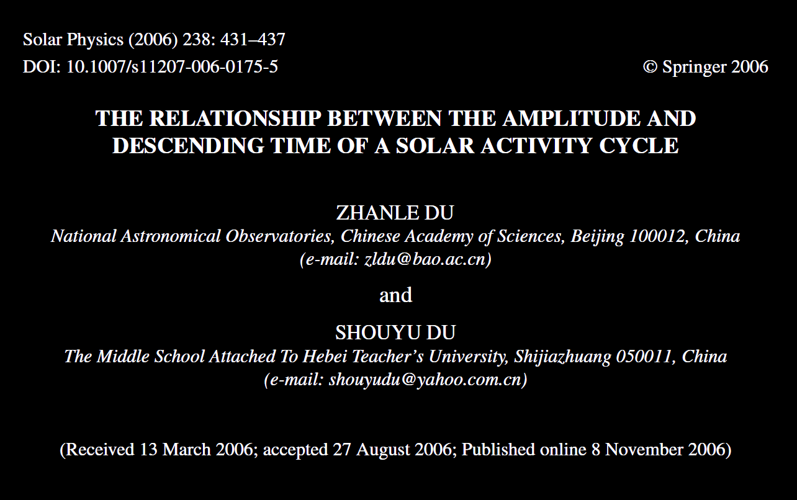
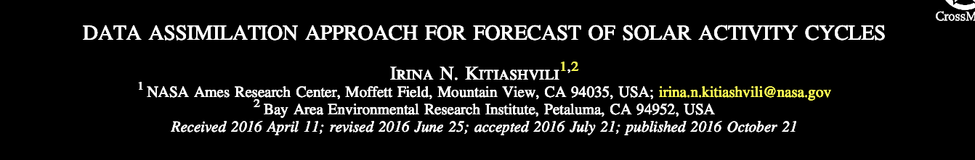

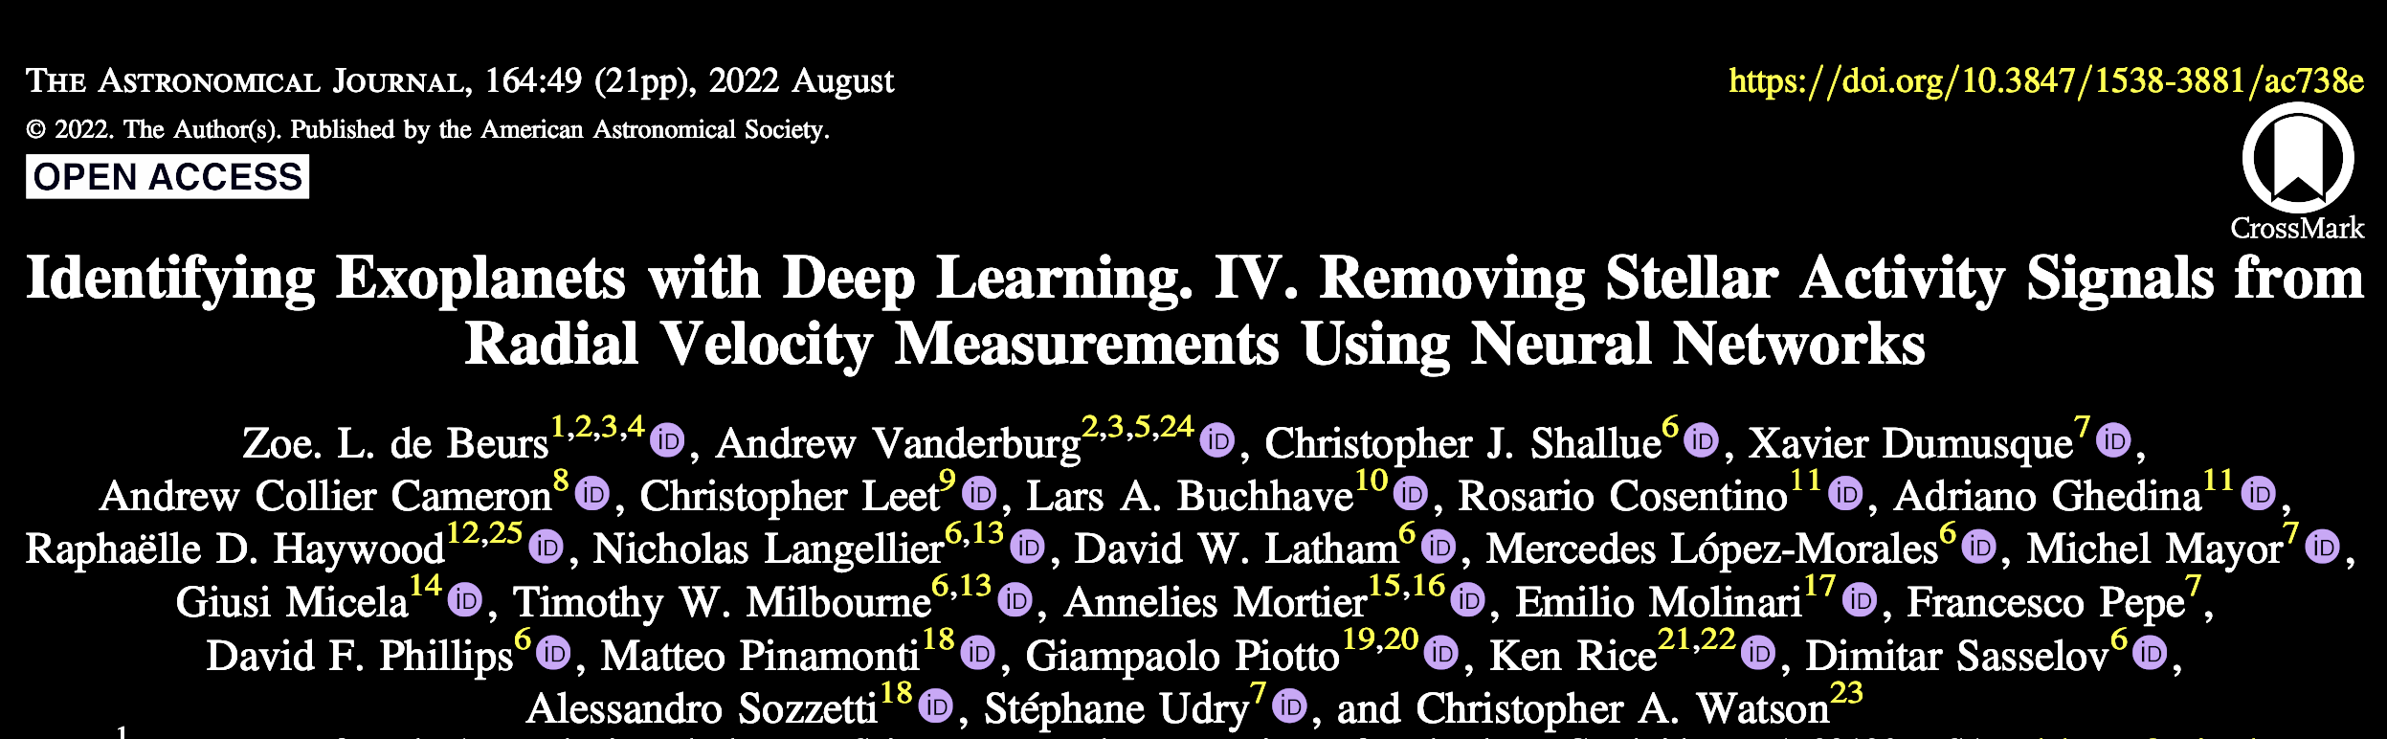
OTHER APPROACHES
Data Assimilation
Linear Regression
Machine Learning
Notes:
So, apart from simulating the magnetohydrodynamics of the sun, how else have people tried to predict these cycles?
Well, some of the methods I’ve come across include Data Assimilation: a method which combines sunspot data with dynamo theory, in an attempt to gain better predictions. The problem with this method is that there is still too much emphasis on the sunspot theory, which is not understood well enough to help us predict future cycles.
Others have tried modelling certain aspects of the solar cycle, such as this paper, which claims to have found a linear relationship between the amplitude of a cycle and its ‘descending time’ three cycles earlier (how quickly we go from a maxima to a minima).
I stumbled across this paper decided I could reproduce that, and so I used linear regression to test their findings. The white dots are data for several cycles.
For those of you familiar with statistics I calculated the Maximum likelihood estimate parameters (MLE), which is the line seen in green, as well as the Maximum a posteriori probability parameters, shown in pink.
The light blue traces you can see behind is from an MCMC sampler, and this gives us a good indication of how confident in our model.
The important point here is that there is quite a big spread in these models, and if we take a look at the figure in the top right, that is the probability distribution of our calculated gradient. The maximum probability occurs at a gradient of about -1.78, but the errors are huge, and there's a pretty big probability of the gradient being just zero, which means no correlation at all.
So in summary, I was able to very quickly show that there isn’t a statistically significant correlation between the amplitude and descending time.
Okay, and the final approach I wanted to mention are Neural Networks, which are a branch of machine learning. I’m sure you’ve all heard of neural networks in light of all this ChatGPT news, so I won’t go into detail right now about them, but they will feature later in the talk, as they are one of the methods I am using to try and predict solar cycles.

Slide 9
MACHINE LEARNING
PROBABILISTIC
Uses data to build models & make predictions
Bayesian approach, providing posterior distributions for model parameters
Notes:
So machine learning, which I'm sure you've all heard of, is when we use data, and ONLY data to build models, and make predictions. There is absolutely no solar physics involved in any of these models.
Probabilistic machine learning is a subfield of machine learning that deals with uncertainty in data and models. Unlike traditional machine learning algorithms that output a point estimate, probabilistic machine learning algorithms provide a probability distribution over the output values. This distribution can be used to quantify the uncertainty in the predictions, which is much better than just getting a prediction in the form of a number.
To give a simple example of how this works, lets take a look at some preliminary tests I did. So, this paper here by Du and Du claims that there is a linear relationship between a solar cycle and its descending time (the time taken to come down from the solar maximum to the minimum).

Slide 10
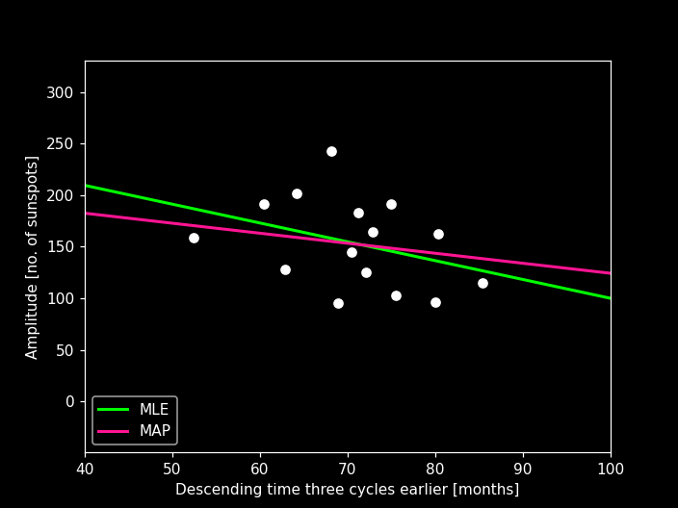
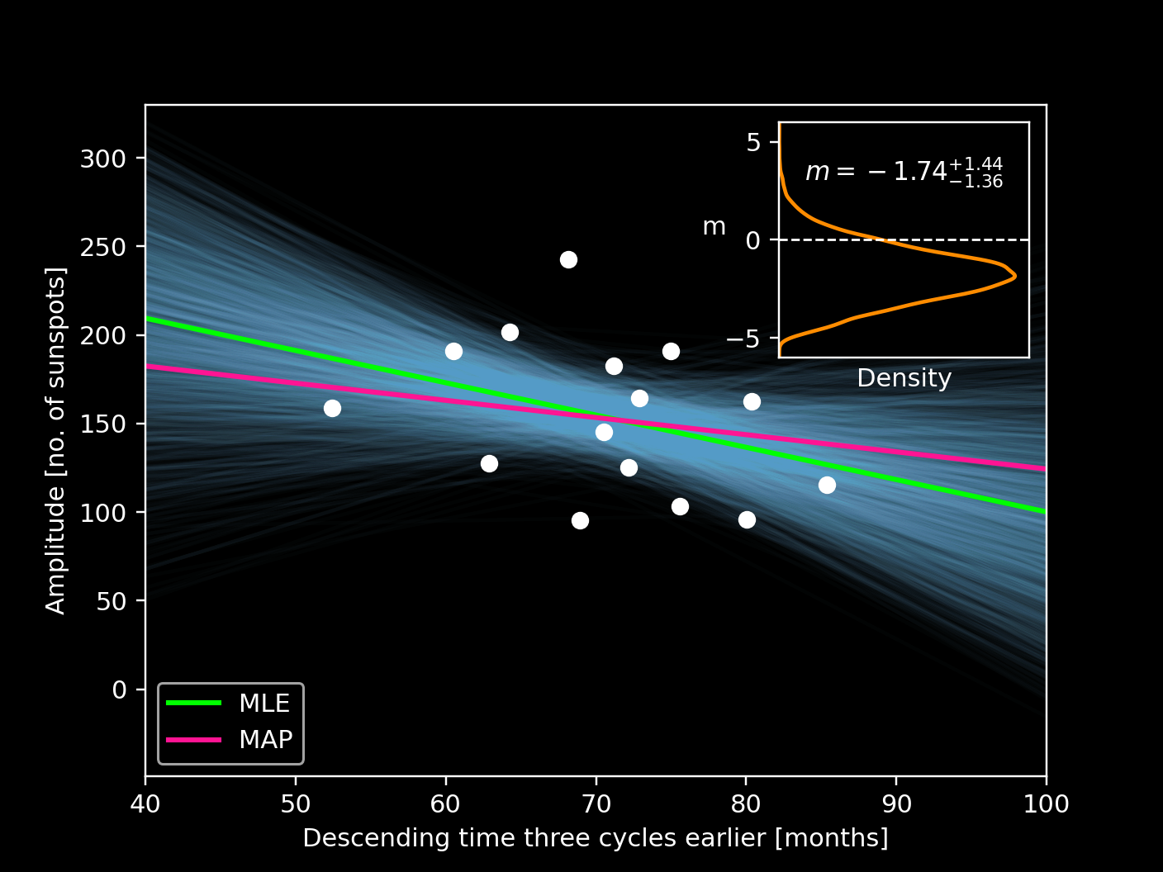

MACHINE LEARNING
PROBABILISTIC
Uses data to build models & make predictions
Bayesian approach, providing posterior distributions for model parameters
$$y=mx+c$$
Notes:
So machine learning, which I'm sure you've all heard of, is when we use data to build models, and make predictions about future data.
Pr obabilistic machine learning is a subfield of machine learning that deals with uncertainty in data and models. Unlike traditional machine learning algorithms that output a point estimate, probabilistic machine learning algorithms provide a probability distribution over the output values. This distribution can be used to quantify the uncertainty in the predictions, which is much better than just getting a prediction in the form of a number.
To give a simple example of how this works, lets take a look at some preliminary tests I did. So, this paper here by Du and Du claims that there is a linear relationship between a solar cycle and its descending time (the time taken to come down from the solar maximum to the minimum).

Slide 11
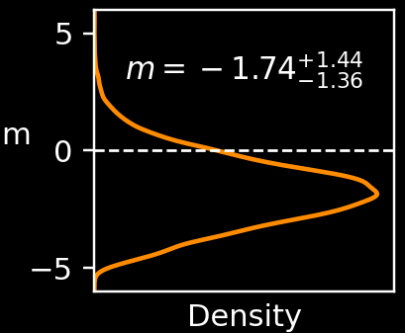
MACHINE LEARNING
PROBABILISTIC
Uses data to build models & make predictions
Bayesian approach, providing posterior distributions for model parameters
Notes:
So machine learning, which I'm sure you've all heard of, is when we use data to build models, and make predictions about future data.
Pr obabilistic machine learning is a subfield of machine learning that deals with uncertainty in data and models. Unlike traditional machine learning algorithms that output a point estimate, probabilistic machine learning algorithms provide a probability distribution over the output values. This distribution can be used to quantify the uncertainty in the predictions, which is much better than just getting a prediction in the form of a number.
To give a simple example of how this works, lets take a look at some preliminary tests I did. So, this paper here by Du and Du claims that there is a linear relationship between a solar cycle and its descending time (the time taken to come down from the solar maximum to the minimum).

Slide 12
GAUSSIAN PROCESSES
A type of probabilistic machine learning
Assigns a probability distribution to each possible function
Notes:
Gaussian processes are one example of Probabilistic Machine learning, and they are powerful tool for making predictions and modelling complex systems.
At their core, Gaussian processes use probability distributions to model the behaviour of a system based on observed data.

Slide 13
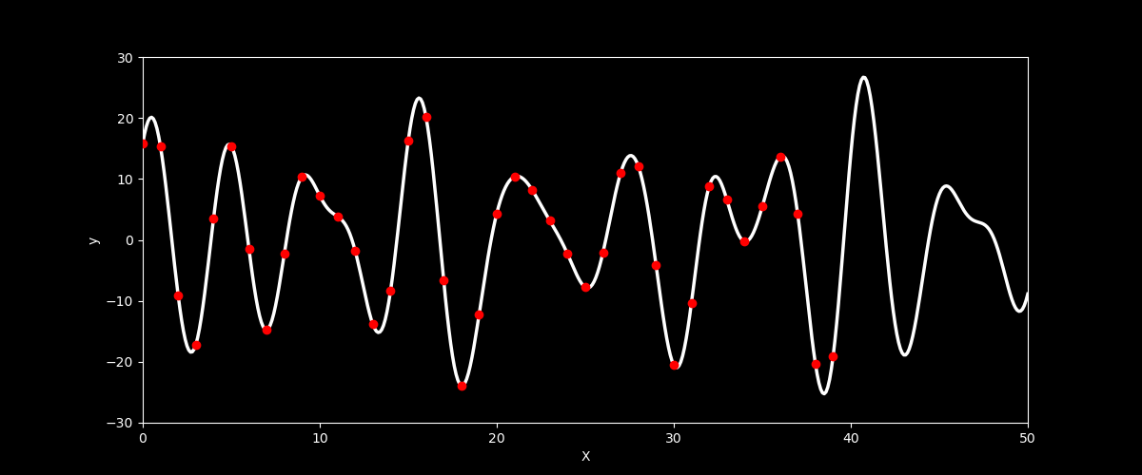
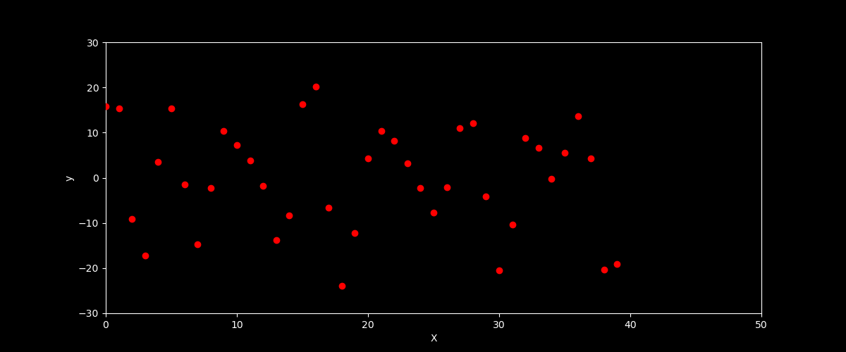
GAUSSIAN PROCESSES
Notes:
Think of it like this: imagine you have a set of points on a graph, and you want to find a curve that passes through all the points. The real curve should look like this. Not only do we want to model this data, but ideally we want to predict what comes next!
A GP would allow you to draw lots of different curves through the points, each curve being a possible function that could fit the data.
Each curve would have a probability distribution that describes how likely it is to be the "true" curve that generated the data.

Slide 14
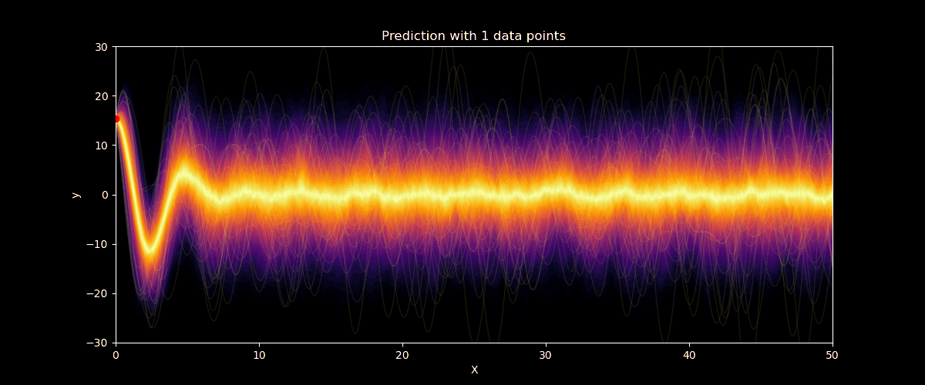
GAUSSIAN PROCESES
Notes:
I’ve tried to illustrate that with this GIF.
Initially, the GP only has one datapoint, and so the function could be anything, but it’s not sure so it quickly tends to it’s mean, which in this case is 0.
With each additional datapoint we add a constraint to the GP, and the modelling becomes more and more accurate, and we see that the uncertainties around the points get very small.

Slide 15
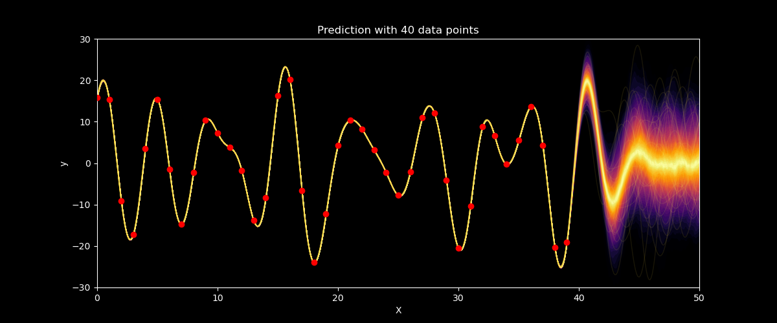
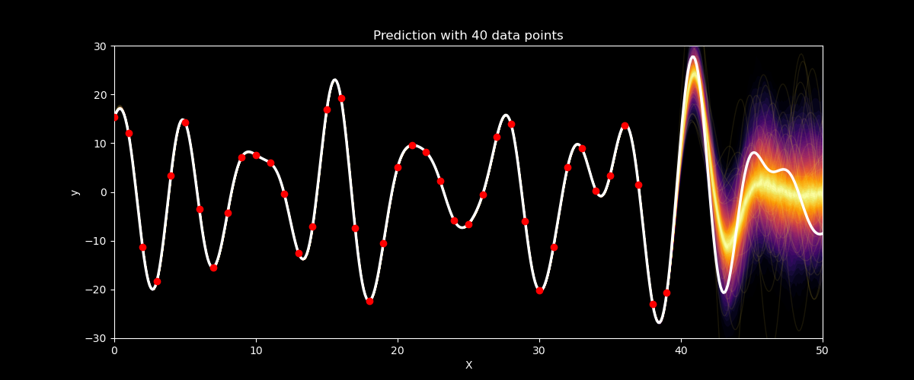
GAUSSIAN PROCESES
Notes:
At the end of the training, we have a perfect model of our data, but the interesting thing is that the uncertainty quickly gets very big as we move away from our final datapoint, and we are just left with our mean of zero once again.
Which isn’t ideal if we want to use them for predicting solar cycles.

Slide 16
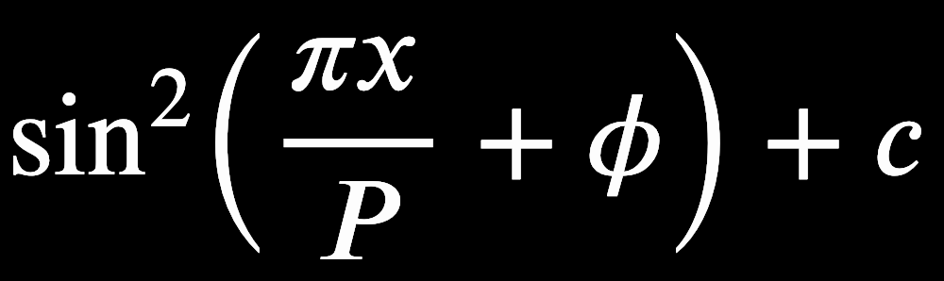
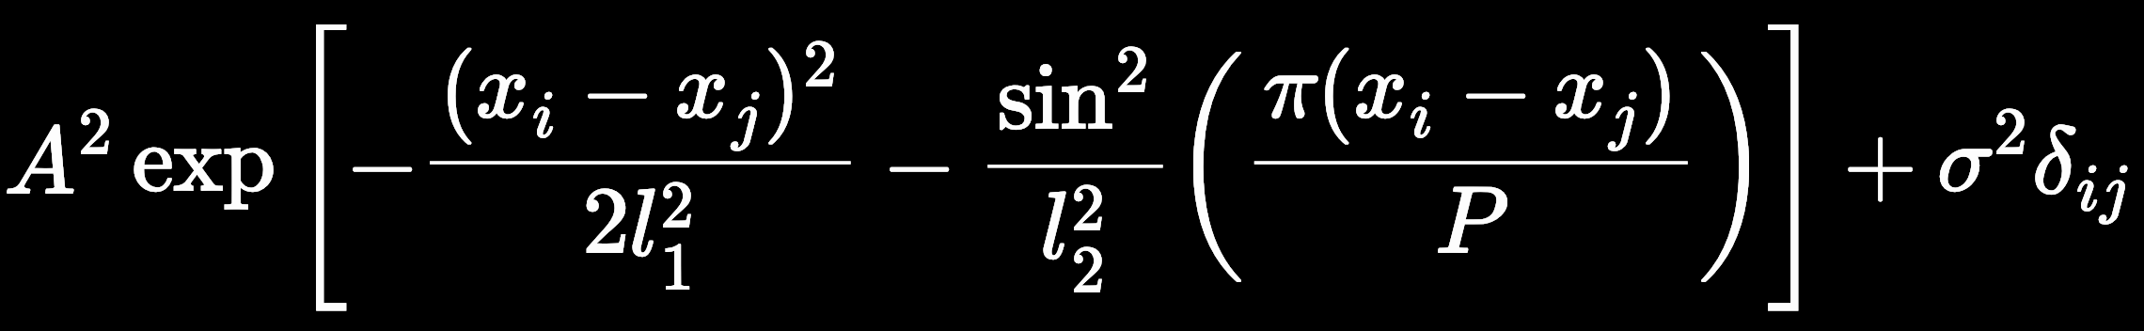
GAUSSIAN PROCESSES
Fully described by its mean and covariance function
long-term trend short-term variation
SAMPLING

Slide 17
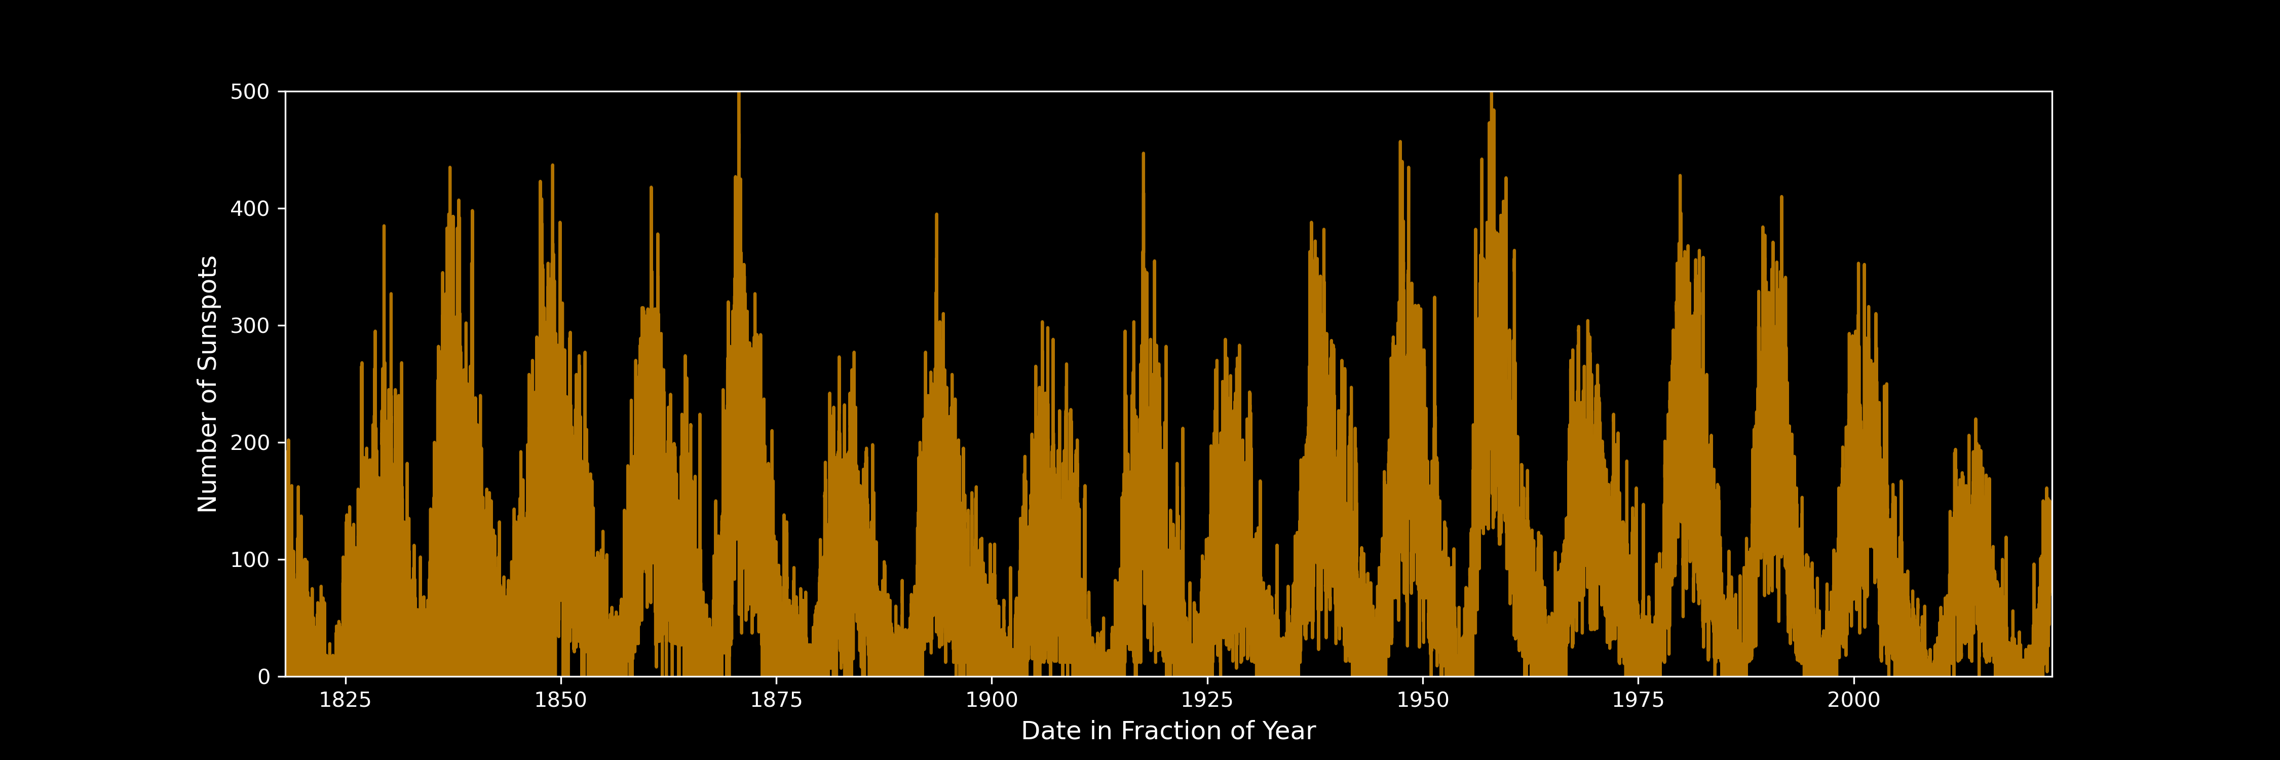
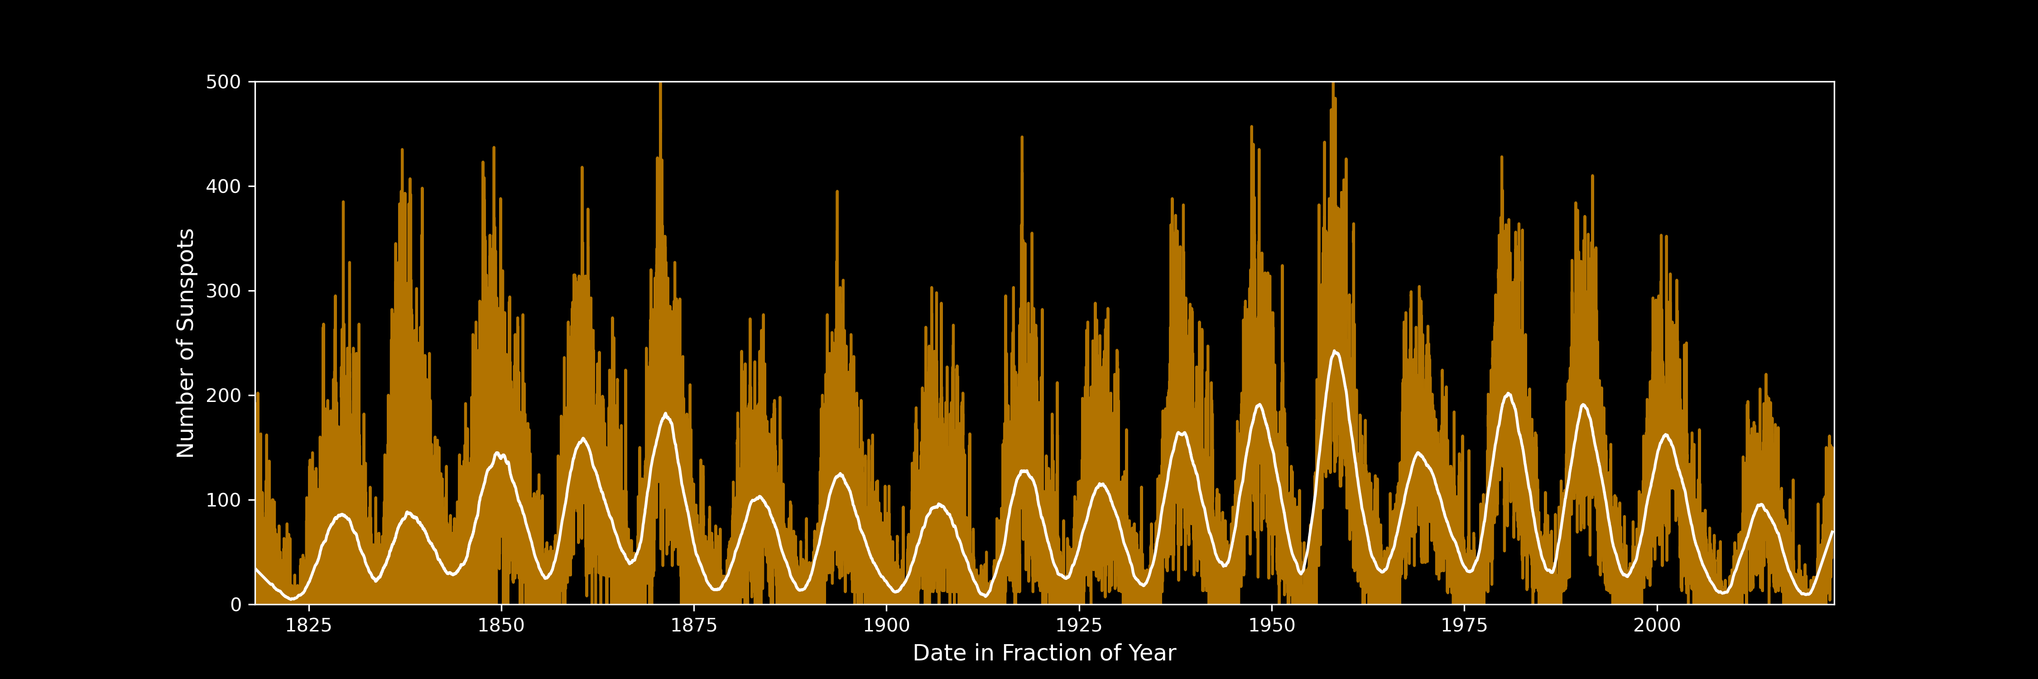
GAUSSIAN PROCESS PREDICTIONS
* Savitzky-Golay Filter
Notes:
Apart from there being loads of data points, its also extremely noisy, so to make running the GP a bit easier I decided to smooth the data using something called a Savitzky-Golay filter.
Don’t worry about what it is or how it works, python pretty much takes care of it all for you.

Slide 18
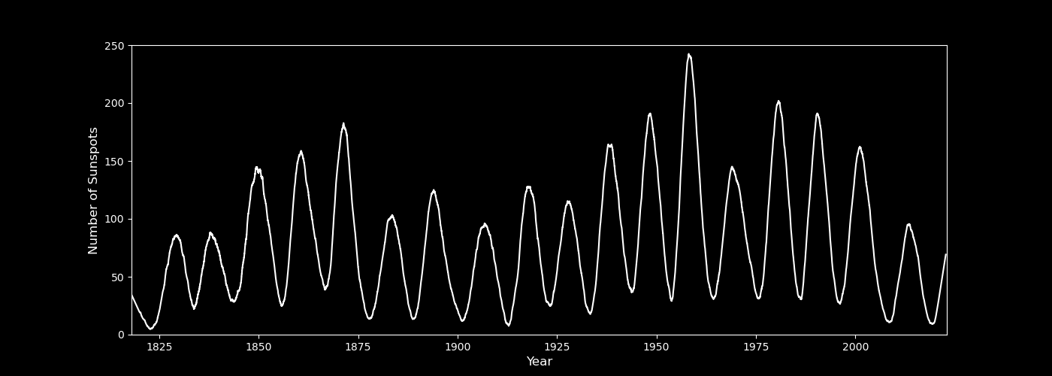
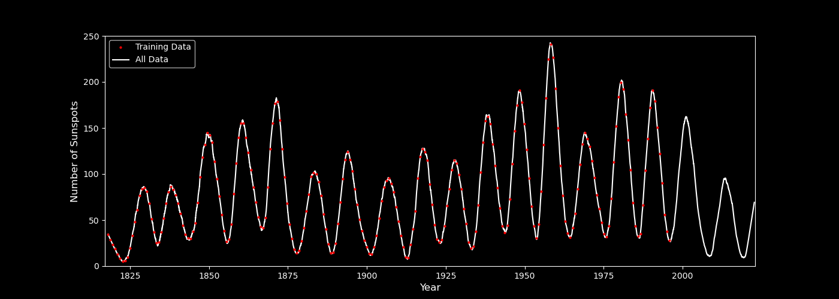


GAUSSIAN PROCESS PREDICTIONS
~ $O(n^{3})$
Notes:
So that’s our nice smoothed data, but it’s still got over 70 thousand points, and one crucial drawback of using GPs is that the computation time scales as n cubes with the number of data points.
So lets just choose a sample of them to train the model with. That’s better.
And when we run it through the GP we get our predictions, hey presto!

Slide 19
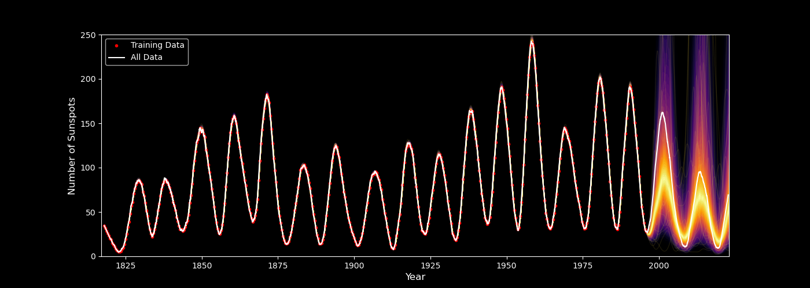
GAUSSIAN PROCESS PREDICTIONS
Notes:
Hey presto, we’ve done it! Like the example before, you can’t see the GP model where it has the training data because it models it pretty much perfectly.
But I left it to predict the last two and a bit cycles, and we can see it doesn’t do a half bad job at it.

Slide 20
GAUSSIAN PROCESS PREDICTIONS
Models the data impeccably
Uncertainty very quickly increases
GP reverts to its mean function
Notes:
Hey presto, we’ve done it! Like the example before, you can’t see the GP model where it has the training data because it models it pretty much perfectly.
But I left it to predict the last two and a bit cycles, and we can see it doesn’t do a half bad job at it.

Slide 21
FUTURE DEVELOPMENTS
Gaussian Processes
Multi-input – radioflux & sunspot area
Neural Networks
LSTMs
Transformer Neural Networks
Testing on Stellar Cycle data
Notes:
And just finally I’d like to talk about what I’m currently working on, and what I’m planning on doing for the rest of this project.

Slide 22
CONCLUSION
Solar Cycle physics is hard to model
Others have tried, but with little success
Machine Learning simplifies the task
Gaussian Processes show the most promise
Great at modelling the data
Fail at long-term predictions
Solar cycles might be unpredictable

Slide 23
QUESTIONS?

Slide 24
REFERENCES
Balogh, A et al. (2015) “Introduction to the solar activity cycle: Overview of causes and consequences”. In: The Solar Activity Cycle, pp. 1–15.
Barros, SCC et al. (2020) “Improving transit characterisation with Gaussian process modelling of stellar variability”. In: Astronomy & Astrophysics 634, A75.
Beurs, Zoe L de et al. (2022) “Identifying Exoplanets with Deep Learning. IV. Removing Stellar Activity Signals from Radial Velocity Measurements Using Neural Networks”. In: The Astronomical Journal 164.2, p. 49.
Charbonneau, Paul (2020) “Dynamo models of the solar cycle”. In: Living Reviews in Solar Physics 17.1, pp. 1–104.
Czesla, S et al. (2009) “How stellar activity affects the size estimates of extrasolar planets”. In: Astronomy & Astrophysics 505.3, pp. 1277–1282.
Du, Zhanle and Shouyu Du (2006) “The relationship between the amplitude and descending time of a solar activity cycle”. In: Solar Physics 238.2, pp. 431–437.
Kitiashvili, Irina N (2016) “Data assimilation approach for forecast of solar activity cycles”. In: The Astrophysical Journal 831.1, p. 15.
Press, William H and Saul A Teukolsky (1990) “Savitzky-Golay smoothing filters”. In: Computers in Physics 4.6, pp. 669–672.

Slide 25
REFERENCES
Figures:
Dynamo Model - https://commons.wikimedia.org/wiki/File:Dynamo_Theory_-_Outer_core_convection_and_magnetic_field_generation.svg
Solar Cycles GIF - https://nasa.tumblr.com/post/629345055470239745/tracking-the-suns-cycles
Sunspots – https://www.space.com/sunspots-formation-discovery-observations
Dynamo Simulation - https://physics.aps.org/story/v27/st17

Slide 26
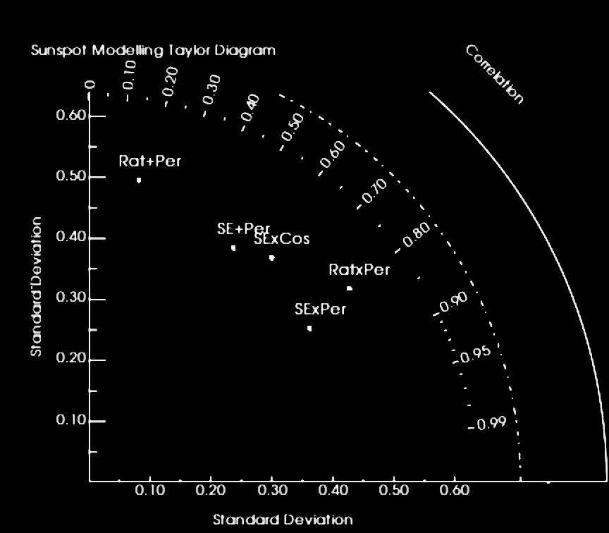
TAYLOR DIAGRAM

